Slide 1
Community Meeting GBFD
04/15/2025
Good Evening and Welcome

Slide 2
Community Meeting Agenda
04/15/2025
The Community Meeting is not a Business Meeting!
Meet Board
Meet Your Fire Officers
Meet Your Volunteer Firefighters
2025 Accomplishments to Date
2024 Accomplishments
Plan for the next 10 years
Community Involvement

Slide 3
Community Meeting
04/15/2025
Board Members
  President: Brian Woods
  Secretary: Lela Warbington
  Treasurer: Angie Goudreault
  Trustee: Tony Baggett
  Trustee: Empty
  Volunteer Bookkeeper: Marisa Felps

Slide 4
Community Meeting
04/15/2025
Fire Officers
  Chief: Richie Dodge
    Captain: Tony Baggett
    Captain: Evan McGlothen
    Lieutenant: Sean McQuade
    Lieutenant: Brian Cook

Slide 5
Community Meeting
04/15/2025
Volunteers
  GBFD Roster (version 1).xlsb - Copy.xlsx

Slide 6
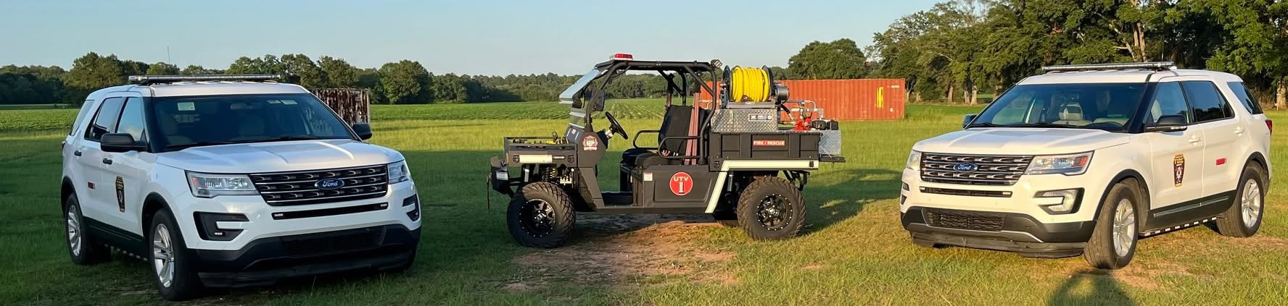
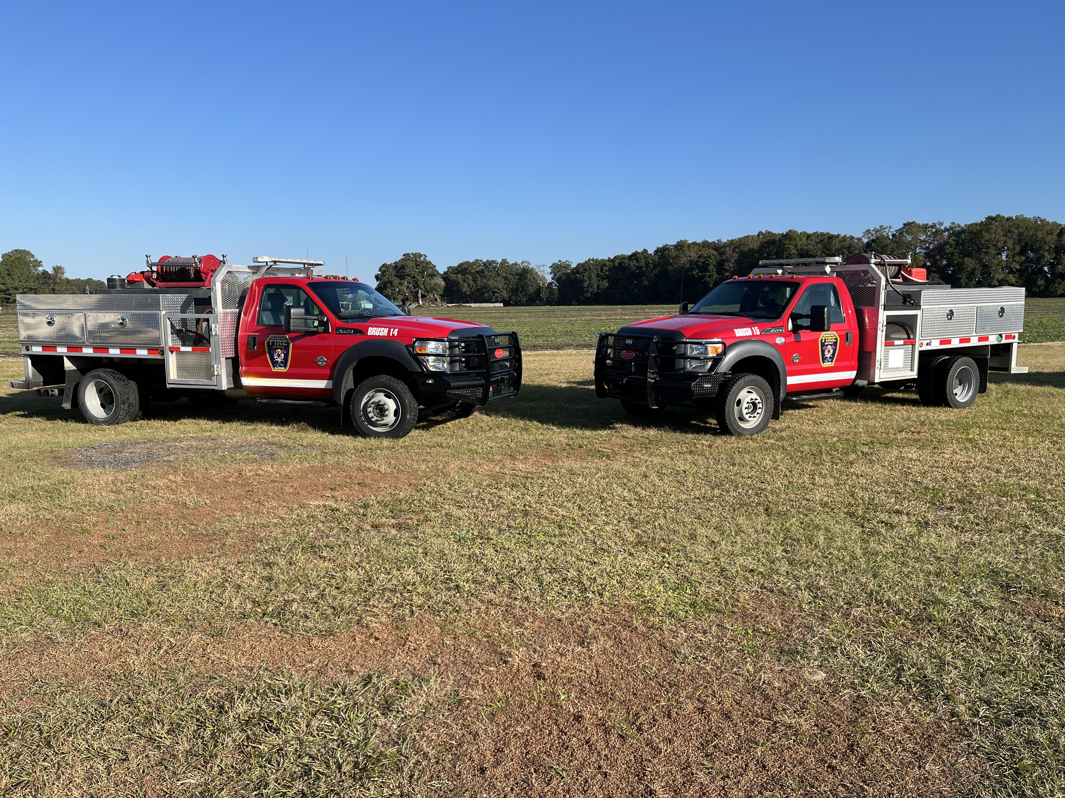
Community Meeting
04/15/2025
2024 Accomplishments
Increased Budget From Fire Fees
Increased Grant Knowledge
New Fire Administration
2 Sprint SUV's
Purchase of 2 Brush Trucks 2014 models (used)
Purchase of UTV and Trailer
Donated Forestry Truck to Georgetown FD
Purchase of Much Needed Fire Hose
Purchase of 2 Additional AED's (50% Grant)

Slide 7
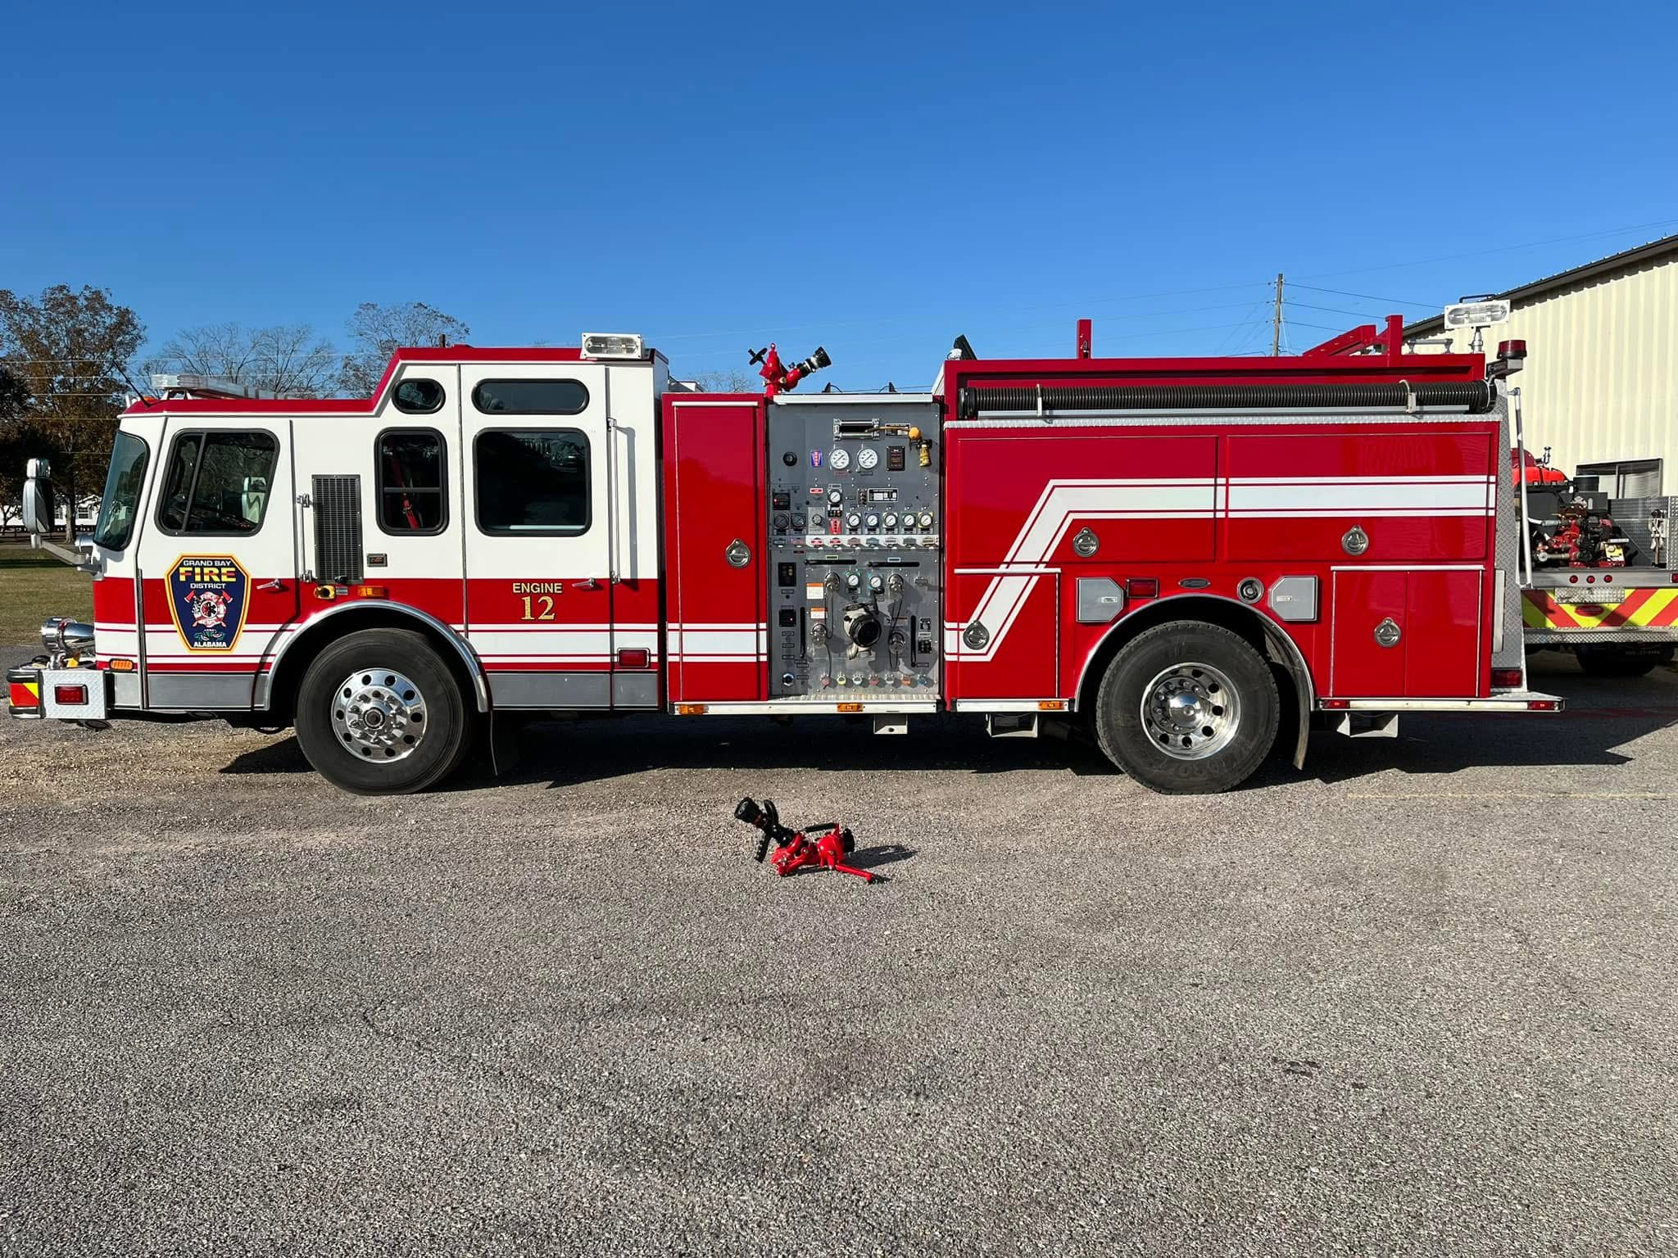

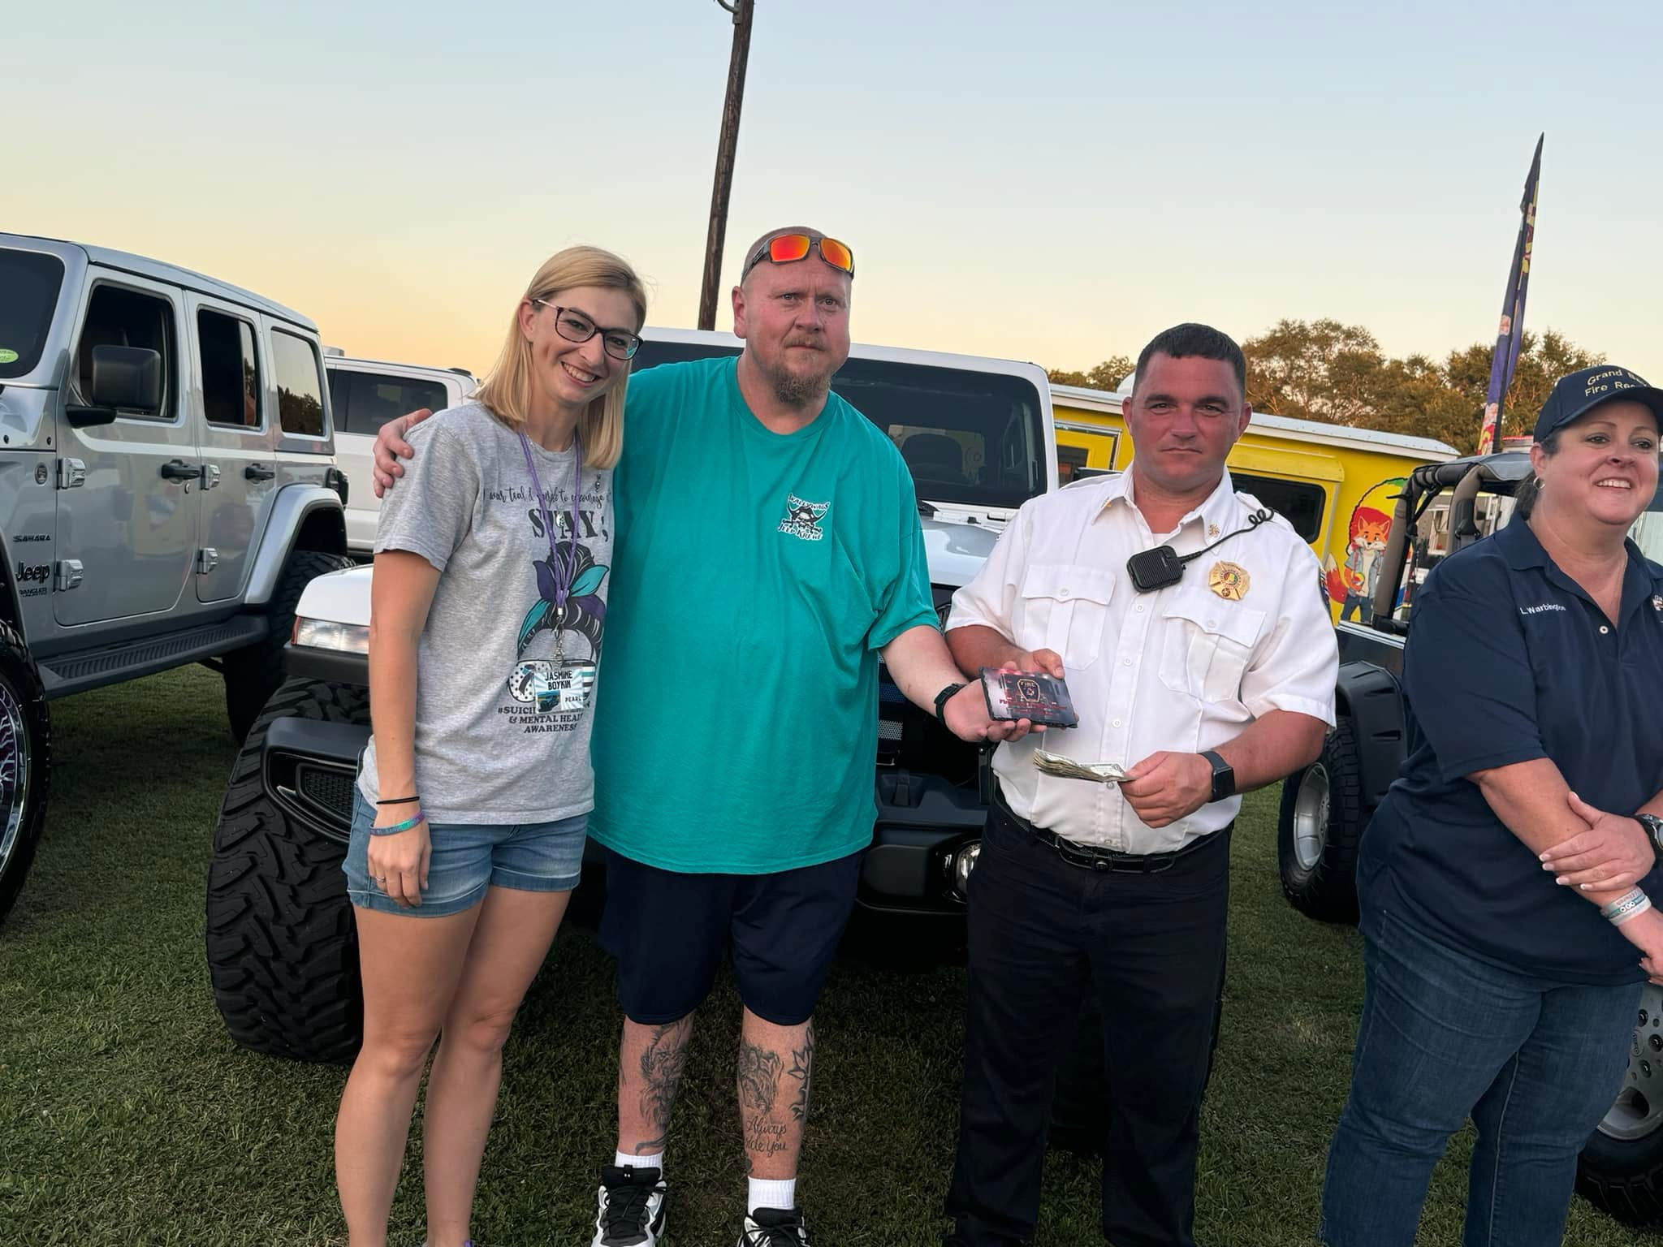
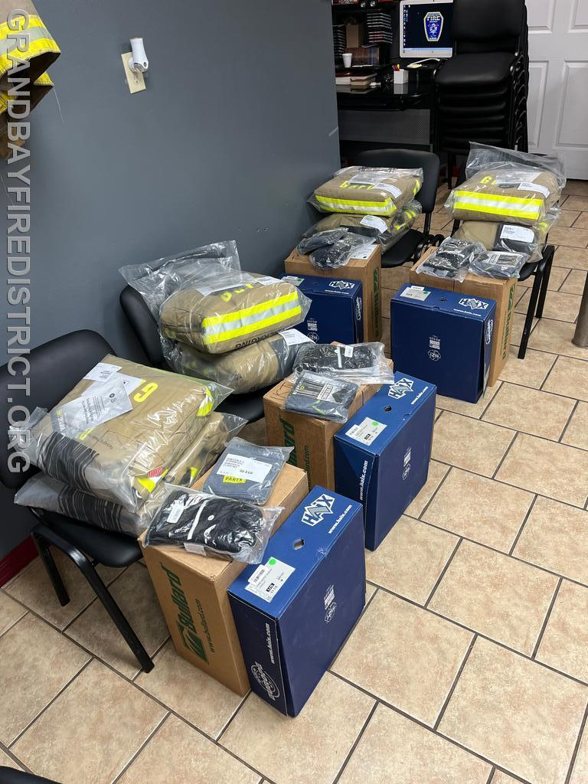
Community Meeting
04/15/2025
2024 Accomplishments
Purchased Engine 12 (used)
New Sets of PPE (some purchased with RC&D Grant)
1st Annual Food Truck Event (success)

Slide 8
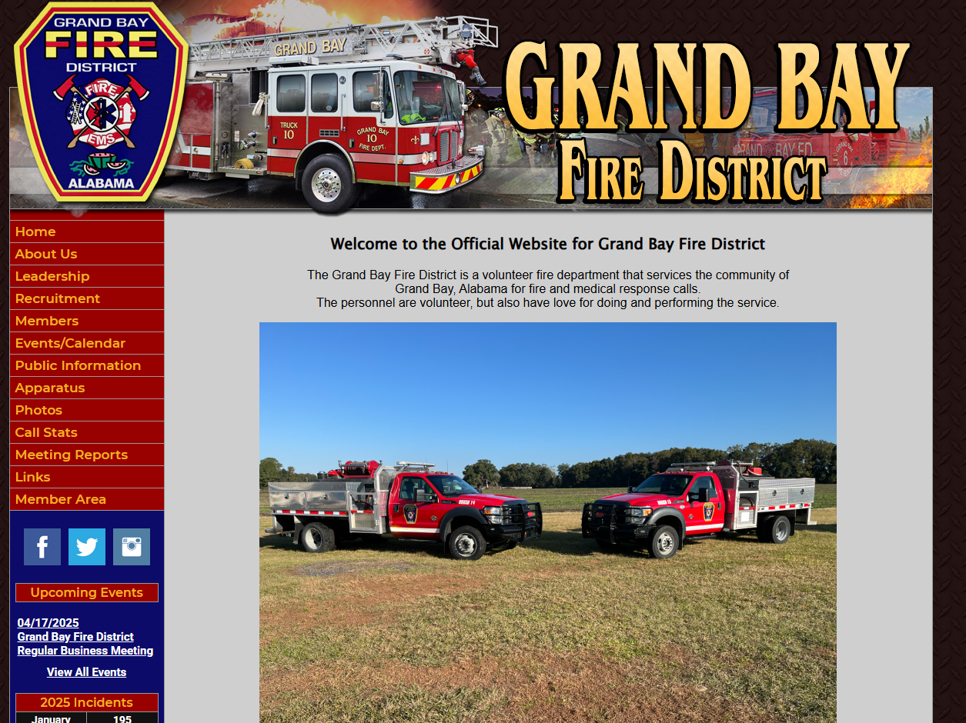
Community Meeting
04/15/2025
2024 Accomplishments
Grand Bay Fire District Website
  grandbayfiredistrict.org
Microsoft Account for Non-Profit
Quickbooks Online (techsoup non-profit)
Treasurer and Bookkeeper Cert Classes with State of Al.
Fuel Card (ease and full transparency)
Teams Meetings
Shortened Meeting Times
All Meeting Minutes and Financials on Website
Name Change with State of Alabama
Daily Budget for Chief: (Monthly- $5000.00)

Slide 9
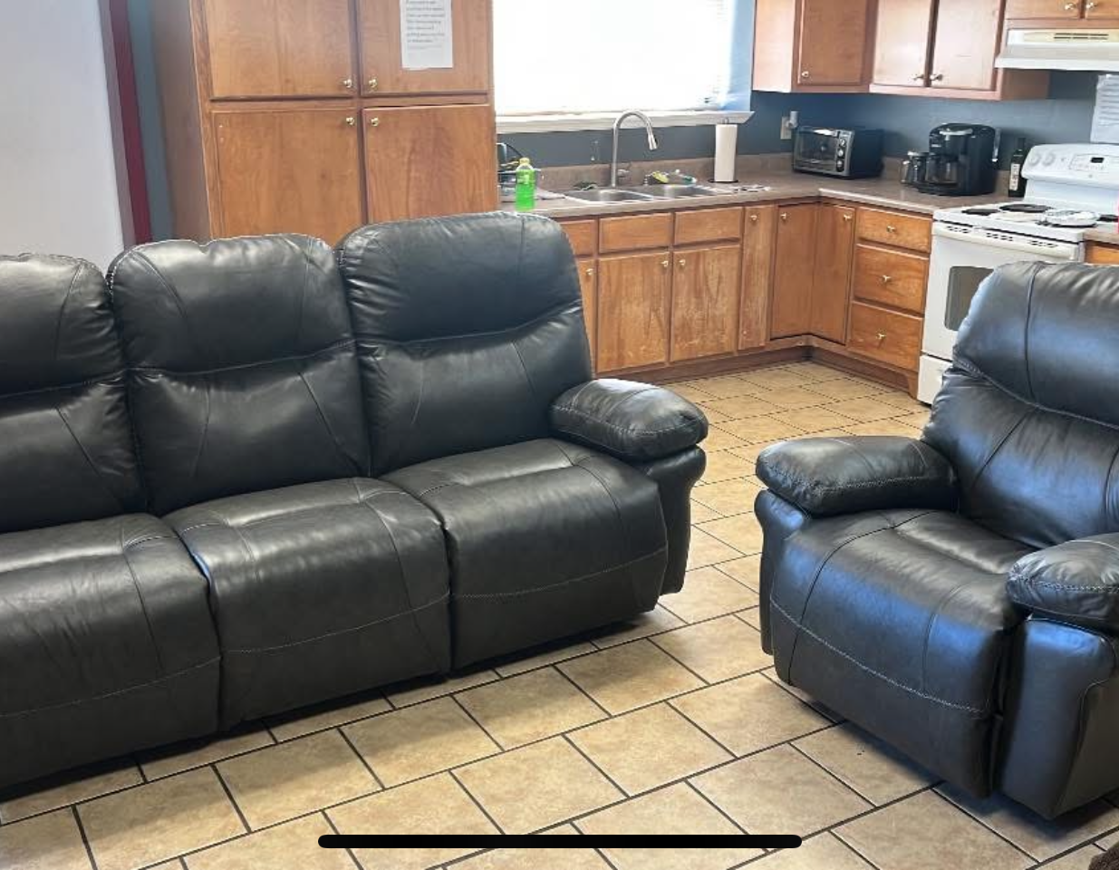
Community Meeting
04/15/2025
2024 Accomplishments
New Industrial Size Air Compressor
New HVAC System at North Station
Electrical Update at North Station
Donation of over 14k for Firefighters
New Training Room Setup (Meetings)
  Purchased table and chairs
New Camera System
New Electronic Locks
New Printer and Computers for Chief and Firefighters
New Door between Bay and Kitchen

Slide 10
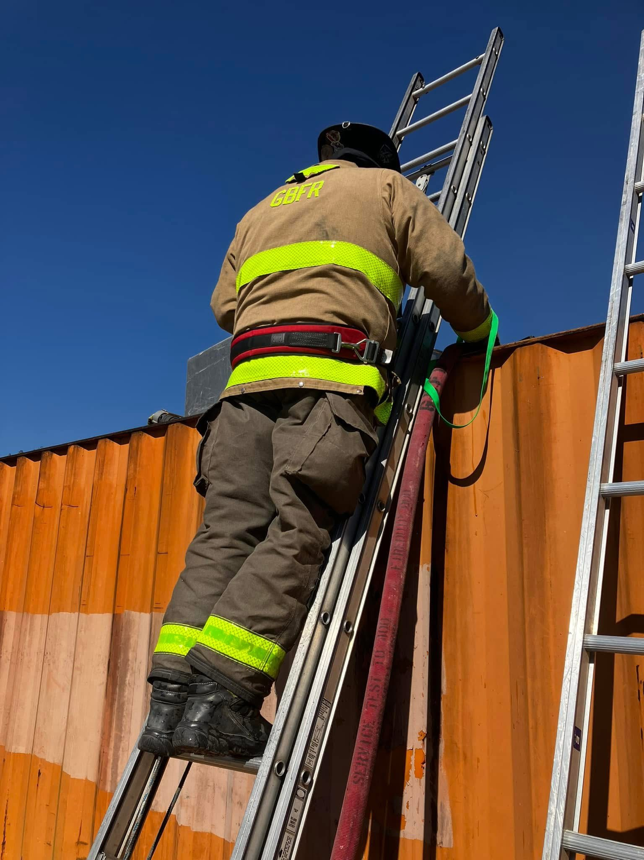
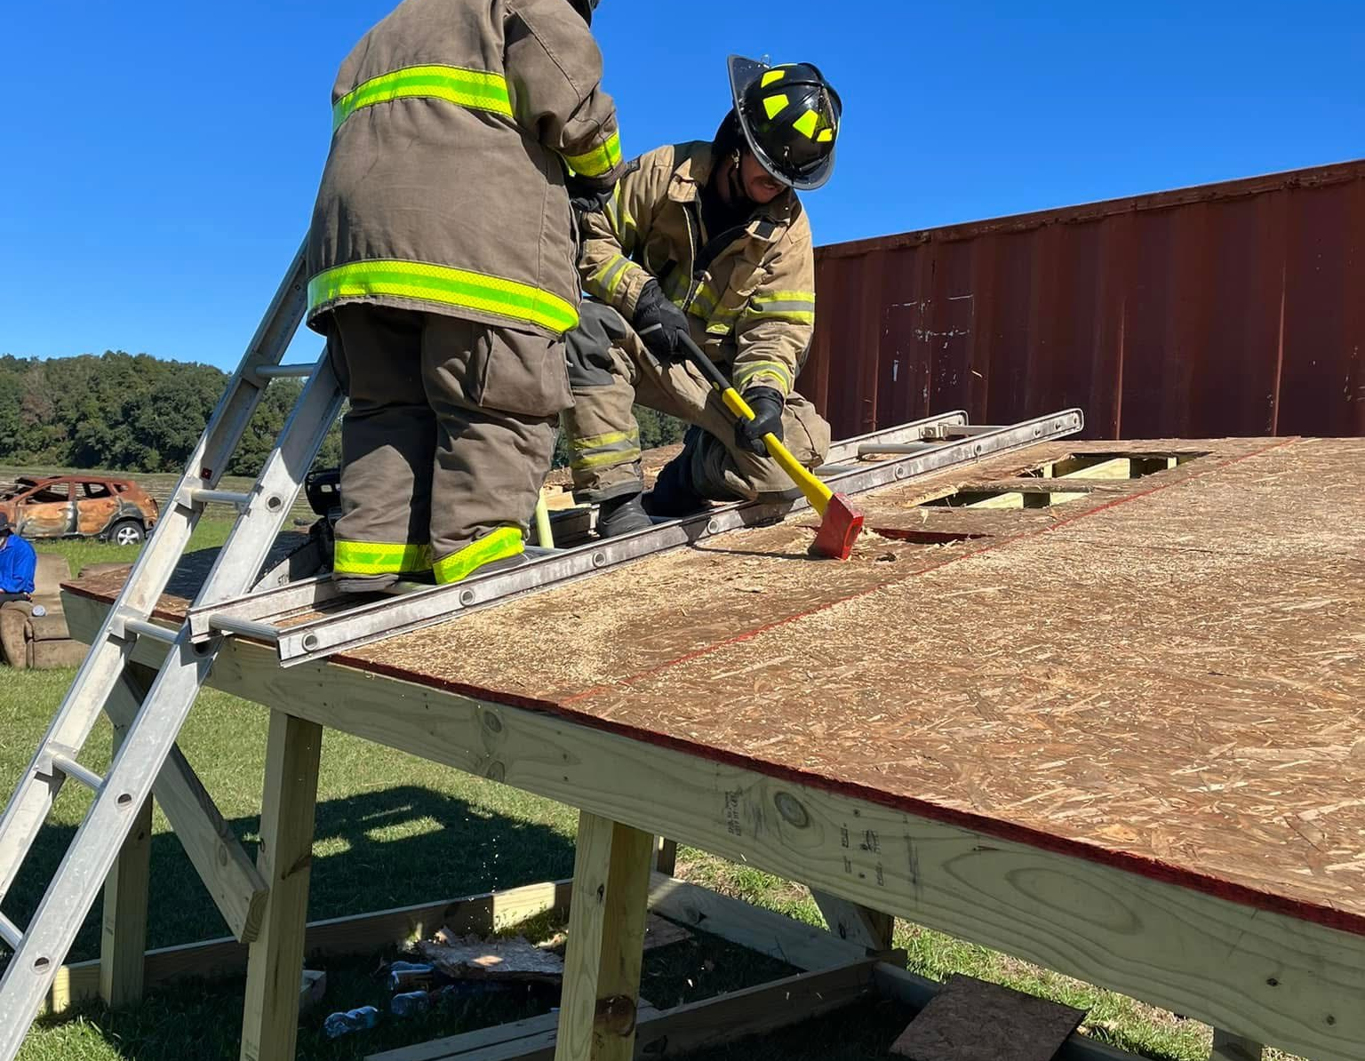
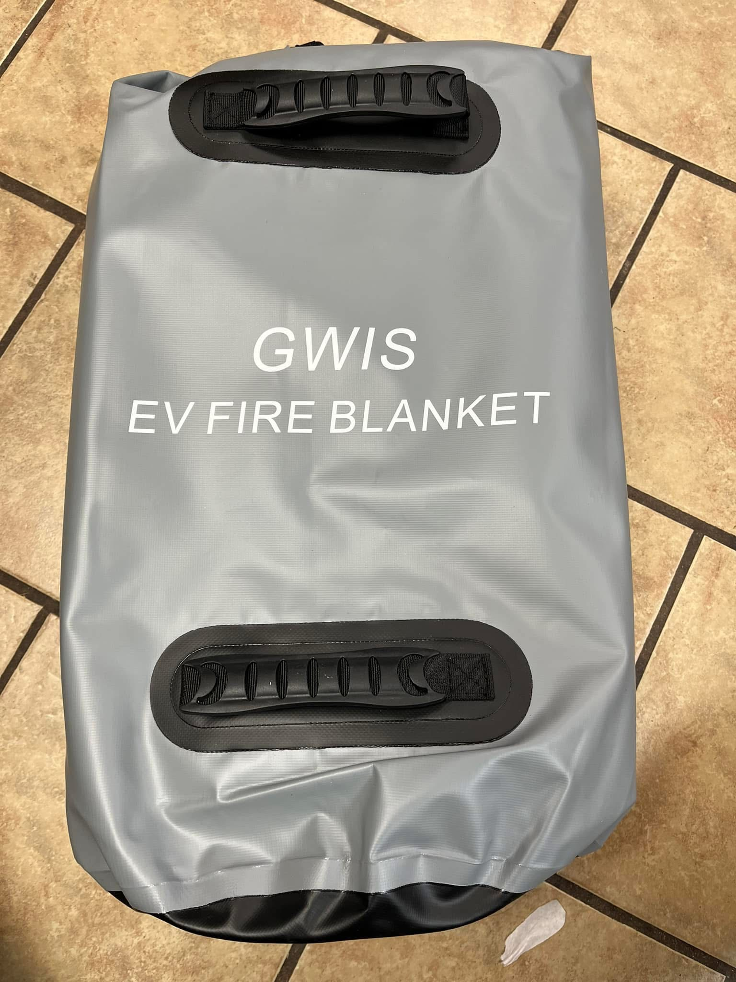
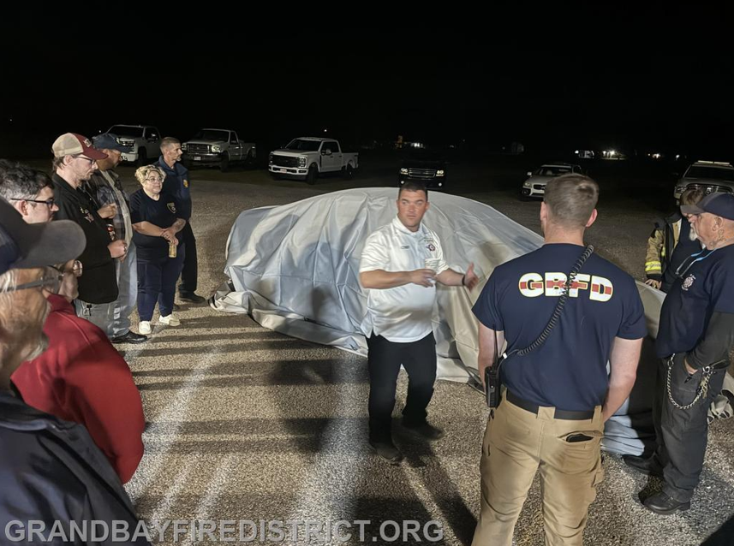
Community Meeting
04/15/2025
2024 Accomplishments
Volunteer FF/Hazmat Classes Sponsored by GBFD
Increased Roster For Volunteers
Increased Involvement with Citizens for Better Grand Bay
Training Props Set Up/Built and Used for Training
EV Blanket Purchase and Training

Slide 11
Community Meeting
04/15/2025
2024 Accomplishments
Updates and Repairs to Engine, Aerial and Tanker
Hose Testing (3rd Party)
Required Fire Extinguishers Purchased and Place In Service
Clean-up of North Station Property

Slide 12
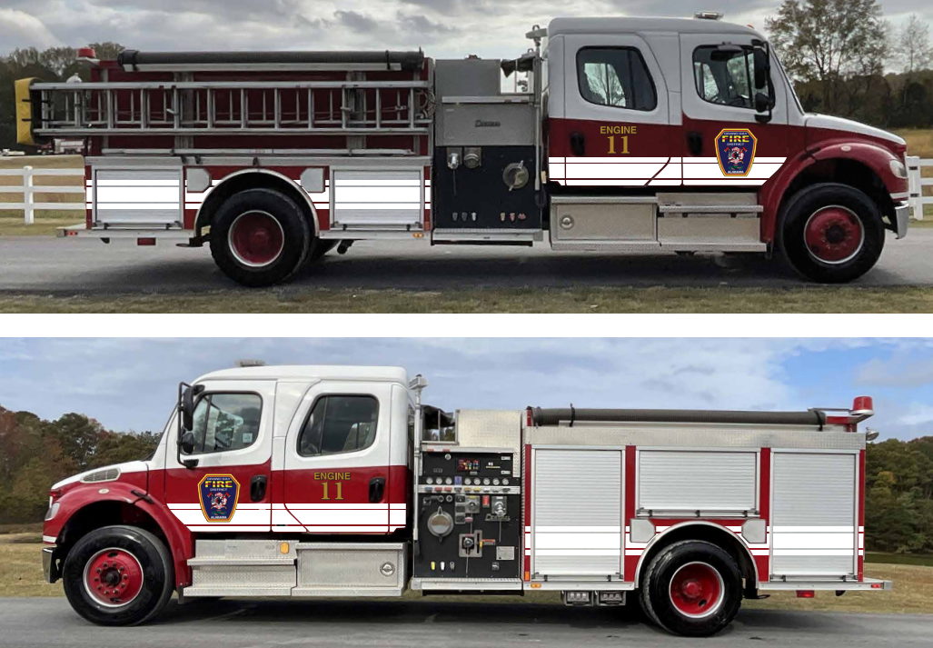
Community Meeting
04/15/2025
2025 Accomplishments
Purchase Another Engine (used-waiting for delivery)
New Furniture Arrives (Purchased from Donations)
Epoxy Engine Bay Floor
Purchase New Large Toolbox for Station (organization)
Purchased Additional Battery Powered Extrication Equipment
Increased Involvement with Political Parties
  Help with Funding
  Help with Grants
  Help with Grant Writing
Continue Food Truck Event (had to cancel due to rain) Reschedule
Purchased New Gear and Hose Racks

Slide 13
Community Meeting
04/15/2025
1-7 Year Plan
New South Station
Purchase Small Parcel of Land for Substation
Build Substation 3-4yrs
Add Fulltime Firefighters with Grant (Combination)
Paid Chief Position (5yrs)
Replacement of Old SCBA's (in Progress) Grants over next 2 yrs
New North Station (Keep old for maintenance shop) 5-7yrs
Send FF's for additional training (Alabama Fire College)
Replace Deputy Chief's Positions (1)
Build Training Facility 4-5yrs
Purchase Electronic Sign for Community Announcements North Station
Add additional Asphalt to North Station Parking and Drive
Knox Box and Preplans for Businesses in the Community
Fire Department Involvement in Permitting for New Construction 2-3yrs
Pay off UTV 1-2yrs
Addition of Personal SCBA Masks for Firefighters
New Ventilation Saw (3) 1-3yrs
Go Completely Paperless
Complete Outfitting of Brush Trucks (Hose and Additional Tools)
Place on the Ballot for an additional increase to help with budget shortfalls (goal is to hit 500K over next 4-5yrs.)
Increase Volunteer Roster (Explorers Program)
Remodel North Station Living Quarters

Slide 14
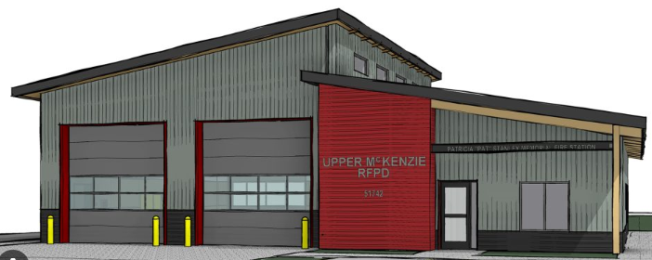
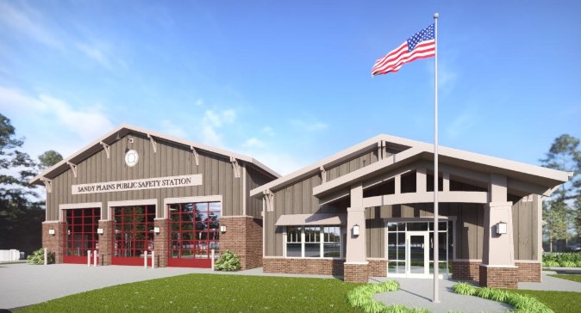
Community Meeting
04/15/2025
GBFD 2025 Budget.docx

Slide 15
Community Meeting
04/15/2025
Questions?

